Slide 1
Office of the Vice President for Research
Human Subjects Protection Program
Community Based Participatory Research (CBPR)

Slide 2
Objectives
What CBPR is
The history and principles of CBPR
The purpose of CBPR
Comparison the CBPR process to that of traditional research
Benefits of CBPR
IRB Review of CBPR projects

Slide 3
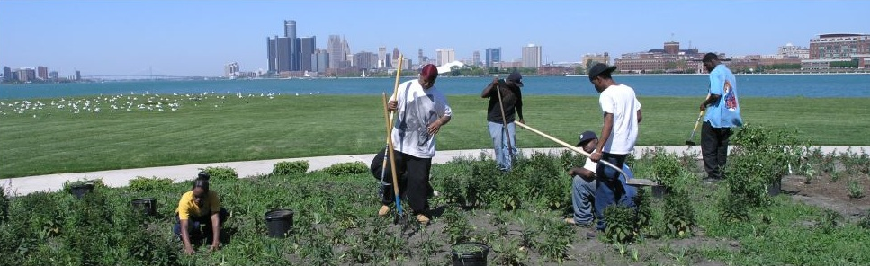
What is CBPR?
“A collaborative approach to research that equitably involves all partners in the research process and recognizes the unique strengths that each brings.” CBPR begins with a research topic of importance to the community and has the aim of combining knowledge with action and achieving social change…”
W.K. Kellogg Foundation (2001)- Community Health Scholars Program
Notes:
CBPR is a collaborative research approach that is designed to ensure and establish structures for participation by communities affected by the issue being studied., representatives of organizations, and researchers in all aspects of the research process to improve health and well-being through taking action, including social change.”
It is a collaborative approach that enables community residents to more actively participate in the full spectrum of research (from conception-design-conduct –analysis –interpretation-conclusions & communication of results) with a goal of influencing change in community health, system, programs and policies.
Community members and researchers partner to combine knowledge and action for social change to improve community health and ofthen eliminate health disparities.
Researchers and community partners join to develop models and approaches to build communication, trust and capacity, with the final goal of increasing community participation in the research process.
CBPR is an approach to health and environmental research meant to increase the value of studies for both researchers and the communities participating in a study.
To expand upon this definition, CBPR involves:
(1) co-learning and reciprocal transfer of expertise, by all research partners, with particular emphasis on the issues that can be studied with CBPR methods;
(2) shared decisionmaking power; and
(3) mutual ownership of the processes and products of the research enterprise.

Slide 4
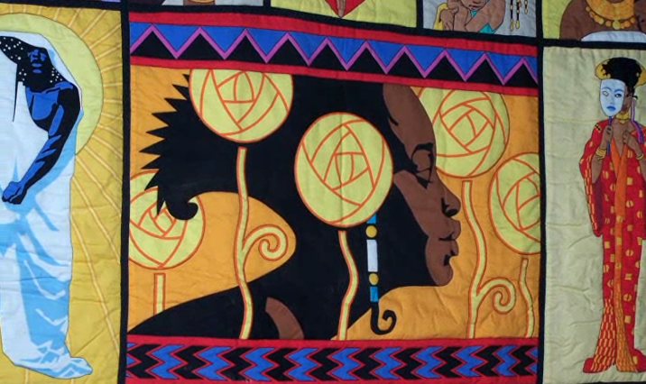
CBPR History
Kurt Lewin (1940s) –Action Research needed to overcome Social inequalities.
Paulo Freire (1970s) - Communities identify their own problems and solutions.
Notes:
Historically, the field of public health has examined environmental and social determinants of health status and involved the public itself in identifying and addressing public health problems.
Recognition of the inequities in health status/health disparities associated with poverty, inadequate housing, lack of employment opportunities, and so on has led to calls for a renewed focus on an ecological approach that recognizes that individuals are embedded within social,political, and economic systems that shape behaviors and access to resources necessary to maintain health .
In the 1940s Kurt Lewin began talking about action research as a means to overcoming social inequalities.
Later Paulo Freire in the 1970s brought to the front issues of having communities identify their own problems and solutions.
In many areas of health promotion and disease prevention, researchers and community advocates are beginning to focus their efforts in the socio-ecologic model, encouraging a greater emphasis on policy and environmental changes that facilitate proactive health choices at the individual level. CBPR is well positioned to address such approaches to health promotion through its ability to mobilize community action. Continued efforts aimed at achieving the best possible balance between research methodologies and community collaboration are critical to advancing the field of health promotion and disease prevention
Researchers and practitioner alike have called for increased attention to complex issues that compromise the health of people. These reflections has given rise to a number of partnership approaches to research and practice called “Community –based/involved/collaborative/centered –The renewed interest in CB approaches to public health in the past years has highlighted CB research as one of the many viable approaches to the development of knowledge and action in the field of public health.

Slide 5
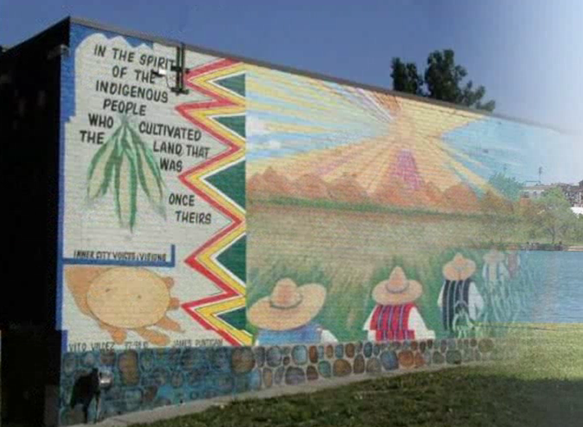
Why use CBPR?
Traditional research approaches have failed to eliminate health disparities.
Community members are tired of having research “done to” them rather than with them.
Community members want research to have concrete, positive outcomes.
Community involvement can produce more valid and reliable results.
Mutual trust and respect can result in increased participation in research.
Notes:
Traditional public health interventions are often disease-specific and individual-focused. These traditional public health approaches may alienate the people they are designed to help by placing the responsibility for wellness on the individual, and by failing to include those most affected in the design and implementation of the interventions.
The CBPR approach is particularly attractive for academics and public health professionals struggling to address the persistent problems of health care disparities in populations that the U.S. Department of Health and Human Services has designated as priority populations (including racial and ethnic minorities; low-income, rural, and inner-city populations; women; and children).
Here are the reasons why more communities and researchers today are increasingly turning to CBPR approaches to research:
1-There is a growing recognition that “traditional” research approaches have failed to solve complex health disparities. Many research designs fail to incorporate multi-level explanations of health and the researchers themselves do not understand many of the social and economic complexities motivating individuals’ and families’ behaviors.
2-Community members themselves, weary of being “guinea pigs” are increasingly demanding that research address their locally identified needs. Traditional researchers often complain about challenges in trying to recruit “research subjects.” These challenges are often a result of community members feeling that researchers have used them and taken findings away for the researchers benefit (e.g., scholarly papers) but the community is left with no direct benefit.
3-Significant community involvement can lead to scientifically sound research. Researchers using participatory methods have found community input invaluable in the design and adaptation of research instruments to make the tools user friendly, applicable and culturally appropriate.
4-Research findings can be applied directly to develop interventions specific for communities. The specific outcome of CBPR research is not simply to find answers to complex social questions but to have those results provide information that can be used by the community to develop its own solutions.
5- This approach to research has the potential to build greater trust and respect between researchers and communities. Trust and respect are two common reasons why individuals do not participate in research. If the research design and methods actively engage community members in an equitable manner, trust is likely to build.

Slide 6
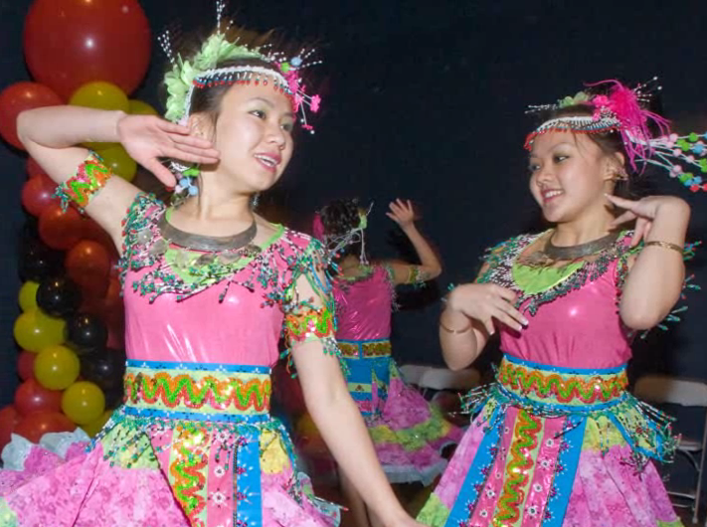
Purpose of CBPR
  “The intent in CBPR is to transform research from a relationship where researchers act upon a community to answer a research question to one where researchers work side by side with community members to define the questions and methods, implement the research, disseminate the findings and apply them.”
  (CCPH CBPR curriculum, 2006)
Notes:
Improving Research Quality. In CBPR, researchers must work with the community to select and justify the strongest
possible research methods, while balancing research rigor with their responsiveness to the community. The researchers must
credit community members with the ability to understand complex research challenges, if presented clearly and thoughtfully. One of the many benefits of making research partners of community members is that they begin to see the long-term gains associated with research, in comparison to the relatively short-term nuisance of data collection activities.
Improving Health Outcomes. Given the long-term nature of true CBPR efforts, individual and community capacity-building efforts ultimately may result in positive health outcomes that have little or nothing to do with those targeted in the initial study. None of the studies
reviewed could accurately predict such long-term and indirect potential benefits of CBPR.

Slide 7
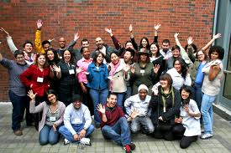
Key Principles of CBPR
Recognizes community as a unit of identity
Builds on strengths and resources within the community
Facilitates collaborative partnerships in all phases of the research
Integrates knowledge and action for mutual benefit of all partners
Developing and Sustaining Community-Based Participator Research Partnerships: A Skill-Building Curriculum. 2006.
Notes:
CBPR attempts to identify and work with existing communities of identity, and/or strengthen a sense of community through collective engagement.
Active collaboration and participation from all partners at every stage of research
Co-learning—i.e., community residents and researchers both contribute and learn from one another
Projects are community-driven
Results are disseminated in useful ways
Research and intervention strategies are culturally appropriate
Defines community as a unit of identity

Slide 8

Key Principles of CBPR
Promotes a co-learning and empowering process that attends to social inequalities
Involves a cyclical and iterative process
Addresses health from both positive and ecological perspectives
Disseminates findings and knowledge gained to all partners
Developing and Sustaining Community-Based Participator Research Partnerships: A Skill-Building Curriculum. 2006.
Notes:
Developing community-based partnerships that are successful in creating relationships and research initiatives that are locally relevant take time and patience.
Active collaboration and participation from all partners at every stage of research
Co-learning—i.e., community residents and researchers both contribute and learn from one another
Projects are community-driven
Results are disseminated in useful ways
Research and intervention strategies are culturally appropriate
Defines community as a unit of identity

Slide 9
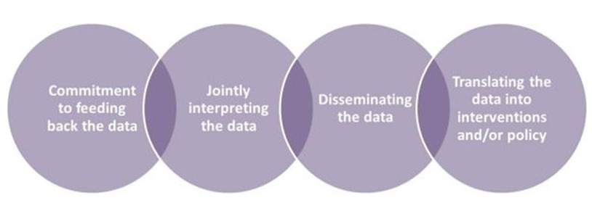
How CBPR Works
http://www.detroiturc.org/about-cbpr/what-is-cbpr.html
Notes:
An interventional study in CBPR studies is defined as an organized and planned effort to change individual behavior, community
norms or practices, organizational structure or policies, or environmental conditions.
While every CBPR project may not involve an intervention, there is a commitment to feeding back the data, jointly interpreting the data, disseminating the data, and translating the data into interventions and/or policy.

Slide 10
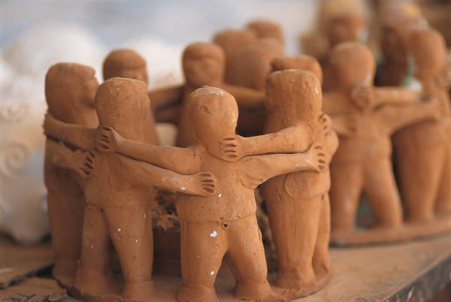
Community members become part of the research team and researchers become engaged in the activities of the community
Notes:
Community members become part of the research team and researchers become engaged in the activities of the community. For a comparison of the how the CBPR process compares to that of traditional research,

Slide 11
CBPR – Component
Full Participation of Community in identifying issues of greatest importance.
Increased motivation to participate in research process.
Health Identified Concern (s)
Traditional Research – Component
Issue identified based on epidemiologic data and funding priorities.
Developing and Sustaining Community-Based Participator Research Partnerships: A Skill-Building Curriculum. 2006.
Notes:
The intent in CBPR is to transform research from a relationship where researchers act upon a community to answer a research question to one where researchers work side by side with community members to define the questions and methods, implement the research, disseminate the findings and apply them. Community members become part of the research team and researchers become engaged in the activities of the community.
Community input was used in some studies to direct change or expand priorities while others used community involvement mainly to confirm their priorities.

Slide 12
CBPR – Component
Community representatives involved with Study design and proposal submission
Increased acceptability of study approach, include funds for community
Study Designed and Funding Sought
Traditional Research – Component
Design based entirely on scientific rigor and feasibility, funding requested primarily for research expenses.
Developing and Sustaining Community-Based Participator Research Partnerships: A Skill-Building Curriculum. 2006.
Notes:
Key words here are “collaborative,” “equitably,” “partners,” “combining knowledge with action” and “achieving social change.” The intent in CBPR is to transform research from a relationship where researchers act upon a community to answer a research question to one where researchers work side by side with community members to define the questions and methods, implement the research, disseminate the findings and apply them. Community members become part of the research team and researchers become engaged in the activities of the community. For a comparison of the how the CBPR process compares to that of traditional research, see Figure 1.1.1
Studies involved the community in helping to set priorities and generate hypotheses

Slide 13
CBPR – Component
Community representatives provide guidance regarding recruitment and retention strategies.
Enhanced recruitment and retention.
Participants recruited and retention system implemented
Traditional Research – Component
Approaches to recruitment and retention based on scientific issues and “best guesses” regarding reaching community members and keeping them involved in the study.
Developing and Sustaining Community-Based Participator Research Partnerships: A Skill-Building Curriculum. 2006.
Notes:
Key words here are “collaborative,” “equitably,” “partners,” “combining knowledge with action” and “achieving social change.” The intent in CBPR is to transform research from a relationship where researchers act upon a community to answer a research question to one where researchers work side by side with community members to define the questions and methods, implement the research, disseminate the findings and apply them. Community members become part of the research team and researchers become engaged in the activities of the community. For a comparison of the how the CBPR process compares to that of traditional research, see Figure 1.1.1

Slide 14
CBPR – Component
Measurement instruments developed with community input and tested in similar population. Potential sensitive issues handled better and increased reliability and validity of instruments.
Measurement instruments designed and data collected
Traditional Research – Component
Measurement instruments adopted/adapted from other studies. Tested primarily with psychometric analytic methods.
Developing and Sustaining Community-Based Participator Research Partnerships: A Skill-Building Curriculum. 2006.
Notes:
Key words here are “collaborative,” “equitably,” “partners,” “combining knowledge with action” and “achieving social change.” The intent in CBPR is to transform research from a relationship where researchers act upon a community to answer a research question to one where researchers work side by side with community members to define the questions and methods, implement the research, disseminate the findings and apply them. Community members become part of the research team and researchers become engaged in the activities of the community. For a comparison of the how the CBPR process compares to that of traditional research, see Figure 1.1.1
involvement of the community in making measurement instruments more culturally relevant, or mentioned field-testing their instruments to improve their reliability.

Slide 15
CBPR – Component
Community members help guide intervention development. Assures greater cultural and social relevance to the population served, increasing the likelihood of producing positive results.
Intervention Designed and Implemented
Traditional Research – Component
Researchers design the intervention based in literature and theory.
Developing and Sustaining Community-Based Participator Research Partnerships: A Skill-Building Curriculum. 2006.
Notes:
Key words here are “collaborative,” “equitably,” “partners,” “combining knowledge with action” and “achieving social change.” The intent in CBPR is to transform research from a relationship where researchers act upon a community to answer a research question to one where researchers work side by side with community members to define the questions and methods, implement the research, disseminate the findings and apply them. Community members become part of the research team and researchers become engaged in the activities of the community. For a comparison of the how the CBPR process compares to that of traditional research, see Figure 1.1.1

Slide 16
CBPR – Component
Community members assist researchers with interpretation, dissemination and translation of findings. Assures greater sensitivity to cultural and social norms and climate and potential group harms and enhances potential for translation of findings into practice.
Data analyzed and interpreted, findings disseminated and translated.
Traditional Research – Component
Researchers report findings from statistical analysis and publish in peer-reviewed journals.
Developing and Sustaining Community-Based Participator Research Partnerships: A Skill-Building Curriculum. 2006.
Notes:
Key words here are “collaborative,” “equitably,” “partners,” “combining knowledge with action” and “achieving social change.” The intent in CBPR is to transform research from a relationship where researchers act upon a community to answer a research question to one where researchers work side by side with community members to define the questions and methods, implement the research, disseminate the findings and apply them. Community members become part of the research team and researchers become engaged in the activities of the community. For a comparison of the how the CBPR process compares to that of traditional research, see Figure 1.1.1

Slide 17

Benefits of CBPR for all partners
Knowledge and skills of partners to work collaboratively and in more participatory ways
Ability to gain a more complex understanding of each other’s strengths and limitations
Relationships and support for each other’s work as well as the establishment of new collaborative efforts through increased networking and collaboration among the partners
Notes:
Done properly, CBPR benefits community participants, health care practitioners, and researchers alike.
CBPR creates bridges between scientists and communities, through the use of shared knowledge and valuable experiences.
This collaboration further lends itself to the development of culturally appropriate measurement instruments, thus making projects more effective and efficient.
Finally, CBPR establishes a mutual trust that enhances both the quantity and the quality of data collected.
The ultimate benefit to emerge from such collaborations is a deeper understanding of a community’s unique circumstances, and a more accurate framework for testing and adapting best practices to the community’s needs

Slide 18

Benefits of CBPR for all partners
Ability of community partners and researchers to learn from and influence one another
Ability and willingness to serve as primary resources for one another
Learn new ways of thinking about their own work
Reconsidering the appropriateness of their measures and techniques in light of new perspectives

Slide 19
Benefits of CBPR
Institutional Partners
Community Partners
Learn more about local resources and services
Gain understanding of community history, culture and dynamics and how interventions in other communities may or may not apply to local circumstances
See evidence of how community experiences can improve the research process
See evidence of how their experiences can improve the research process
Obtain data that validates their concerns to the “outside world” and provides “proof” that policymakers, the media, and other high-level decision makers require before they believe that the issue deserves their attention
See resulting benefits in the community

Slide 20
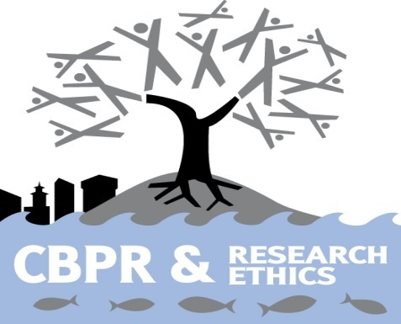
IRB Review of CBRP Projects
The research should aim to facilitate collaborative, equitable partnerships with the community at all stages of the research. This includes, planning and implementing the research and disseminating research results.
Participation of the Community
http://googleext.partners.org/search?q=Community+Based+Participatory+Research&client=PHSIRB&proxystylesheet=PHSIRB&output=xml_no_dtd&site=PHSIRB&submit=search
Notes:
A community-based participatory approach to research is an evolutionary process for investigators and community partners.
Review of protocols will focus on protection of the subjects and communities. As appropriate, investigators should consider the following principles and aim to integrate them into their protocol development:

Slide 21
IRB Review of CBRP Projects
Community members should be involved with the identifying the issues of concern and need for the research. This permits building on the community strength and resources and promotes co-learning and capacity building among all partners. This also helps emphasize the local relevance of the issues to be studied.
Participation of the Community
http://googleext.partners.org/search?q=Community+Based+Participatory+Research&client=PHSIRB&proxystylesheet=PHSIRB&output=xml_no_dtd&site=PHSIRB&submit=search
Notes:
a community-based participatory approach to research is an evolutionary process for investigators and community partners.
Review of protocols will focus on protection of the subjects and communities. As appropriate, investigators should consider the following principles and aim to integrate them into their protocol develoment.

Slide 22
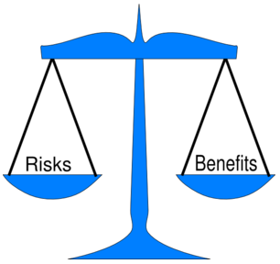
IRB Review of CBRP Projects
The risks and benefits to individuals and the community must be considered. Minimize risks and maximize benefits by:
*Using community collaborators to identify culturally appropriate perspectives.
Risks and Benefits
http://googleext.partners.org/search?q=Community+Based+Participatory+Research&client=PHSIRB&proxystylesheet=PHSIRB&output=xml_no_dtd&site=PHSIRB&submit=search
Notes:
a community-based participatory approach to research is an evolutionary process for investigators and community partners.
Review of protocols will focus on protection of the subjects and communities. As appropriate, investigators should consider the following principles and aim to integrate them into their protocol develoment.

Slide 23
IRB Review of CBRP Projects
*Capacity building within the community to empower
*Investigators need to consider the methods used to be sure they are sensitive and appropriate to the various communities(literacy, language barriers, cultural sensitivities)
Risks and Benefits
http://googleext.partners.org/search?q=Community+Based+Participatory+Research&client=PHSIRB&proxystylesheet=PHSIRB&output=xml_no_dtd&site=PHSIRB&submit=search
Notes:
a community-based participatory approach to research is an evolutionary process for investigators and community partners.
Review of protocols will focus on protection of the subjects and communities. As appropriate, investigators should consider the following principles and aim to integrate them into their protocol develoment.

Slide 24
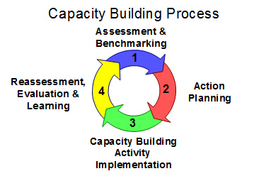
IRB Review of CBRP Projects
If members in the community will be involved in recruitment and/or data collection has education /training been provided?
How are barriers to community participation in planning and implementing the research being addressed?
Capacity Building Opportunities
http://googleext.partners.org/search?q=Community+Based+Participatory+Research&client=PHSIRB&proxystylesheet=PHSIRB&output=xml_no_dtd&site=PHSIRB&submit=search
Notes:
a community-based participatory approach to research is an evolutionary process for investigators and community partners.
Review of protocols will focus on protection of the subjects and communities. As appropriate, investigators should consider the following principles and aim to integrate them into their protocol development.

Slide 25
Example of a CBPR Project:
Poder es Salud/Power for Health
Funded by the Centers for Disease Control and Prevention (CDC)
Purpose: To decrease health disparities in the African American and Latino communities in Multnomah County, Oregon
Key Strategies: Popular Education, Community Health Workers, CBPR
Partners: Latino Network, Emmanuel Community Services, PSU, OHSU, MCHD
Notes:
Findings from a community-based participatory prevention research intervention designed to increase social capital in Latino and African American communities.
Yvonne L Michael, Stephanie A Farquhar, Noelle Wiggins, Mandy K Green
Department of Public Health and Preventive Medicine, Oregon Health and Science University, Portland, OR 97239-3098, USA.
Journal of Immigrant and Minority Health (impact factor: 1.16). 07/2008; 10(3):281-9. DOI:10.1007/s10903-007-9078-2 Source: PubMed
ABSTRACT A community-based participatory research intervention, Poder es Salud/Power for Health, employed Community Health Workers who used popular education to identify and address health disparities in Latino and African American communities in a metropolitan area in the United States.
We assessed participants' social capital (social relations that have productive benefits/social support ), self-rated health, and depressive symptoms at baseline and at the end of the intervention. Social support and self-rated health improved while depressive symptoms decreased. Public health interventions involving diverse communities that are designed to build upon assets, such as existing levels of social capital, may improve health in those communities.

Slide 26
Bibliography
* Agency for Healthcare Research and Quality
Advancing Excellence in Health Care - www.ahrq.gov
*The Detroit Community-Academic Urban Research Center- http://www.detroiturc.org/
*Developing and Sustaining Community-Based Participatory Research Partnership: A Skill-Building Curriculum - http://depts.washington.edu/ccph/cbpr/index.php
* Israel ET Al, 1998. Review Of Community-based
Research: Assessing Partnership Approaches To Improve Public Health Public Health. 19:173–202

